Slide 1
Fundamental Programming in JAVA
One-Dimensional Arrays

Slide 2
Objectives
To declare array reference variables and create arrays.
To obtain array size using arrayRefVar.length and know default values in an array.
To access array elements using indexes.
To declare, create, and initialize an array using an array initializer.
To simplify programming using the foreach loops.
To copy contents from one array to another.
To program common array operations (displaying arrays, summing all elements and finding the minimum and maximum).

Slide 3
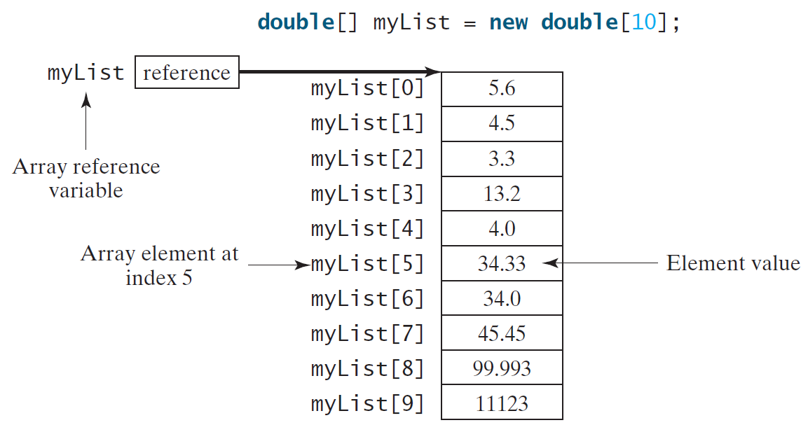
Introducing Arrays
Array is a data structure that represents a collection of the same types of data.

Slide 4
Array Declaration
The syntax for declaring an array variable is:
datatype[] arrayRefVar;
Example:
double[] myList;
4

Slide 5
Array creation
The syntax for creating the array is:
arrayName = new DataType[arraySize];
Example :
myList = new double[10];

Slide 6
Declaring and Creating in One Step
Examples:
datatype[] arrayRefVar = new datatype[arraySize];
double[] myList = new double[10];
double [ ] marks = new double [45];
int number [ ] = new int [100];

Slide 7
Declaring, creating, initializing Using the Shorthand Notation
double[] myList = {1.9, 2.9, 3.4, 3.5};
This shorthand notation is equivalent to the following statements:
double[] myList = new double[4];
myList[0] = 1.9;
myList[1] = 2.9;
myList[2] = 3.4;
myList[3] = 3.5;

Slide 8
CAUTION
Using the shorthand notation, you have to declare, create, and initialize the array all in one statement. Splitting it would cause a syntax error. For example, the following is wrong:
double[] myList;
myList = {1.9, 2.9, 3.4, 3.5};

Slide 9
Alternate Array Declaration
Previously we showed arrays being declared: double[] myList;
However, the brackets can also be after the array name: double myList[];
These are equivalent but the first style is typical.
Multiple arrays can be declared on the same line.
double[] myList, codes, scores;
With the alternate notation each variable must have brackets.
double myList[], codes[], scores;
The scores variable in this instance is simply a double variable.

Slide 10
Processing Array Contents
Processing data in an array is the same as any other variable.
grossPay = hours[3] * payRate;
Array elements can be used in relational operations:
if(cost[20] < cost[0]) {
//statements
}
They can be used as loop conditions:
while(value[count] != 0) {
//statements
}

Slide 11
The Length of an Array
Once an array is created, its size is fixed. It cannot be changed. You can find its size using
arrayRefVar.length
For example,
myList.length returns 10

Slide 12
Default Values
When an array is created, its elements are assigned the default values as following:
Data type | Default value
byte, short, int ,long | 0
float ,double | 0.0
char | '\u0000'
boolean | false
String, reference to objects | null

Slide 13
Off-by-One Errors
It is very easy to be off-by-one when accessing arrays.
// This code has an off-by-one error.
int[] numbers = new int[100];
for (int i = 1; i <= 100; i++)
numbers[i] = 99;
Here, the equal sign allows the loop to continue on to index 100, where 99 is the last index in the array.
This code would throw an ArrayIndexOutOfBoundsException.

Slide 14
Array Program Tracing
Declare array variable values, create an array, and assign its reference to values
public class Test {
public static void main(String[] args) {
int[] values = new int[5];
for (int i = 1; i < 5; i++) {
values[i] = i + values[i-1];
}
values[0] = values[1] + values[4];
}
}

Slide 15
Array Program Tracing
i becomes 1
public class Test {
public static void main(String[] args) {
int[] values = new int[5];
for (int i = 1; i < 5; i++) {
values[i] = i + values[i-1];
}
values[0] = values[1] + values[4];
}
}

Slide 16
Array Program Tracing
i is less than 5
public class Test {
public static void main(String[] args) {
int[] values = new int[5];
for (int i = 1; i < 5; i++) {
values[i] = i + values[i-1];
}
values[0] = values[1] + values[4];
}
}

Slide 17
Array Program Tracing
After this line is executed, value[1] is 1
public class Test {
public static void main(String[] args) {
int[] values = new int[5];
for (int i = 1; i < 5; i++) {
values[i] = i + values[i-1];
}
values[0] = values[1] + values[4];
}
}

Slide 18
Array Program Tracing
public class Test {
public static void main(String[] args) {
int[] values = new int[5];
for (int i = 1; i < 5; i++) {
values[i] = i + values[i-1];
}
values[0] = values[1] + values[4];
}
}
After i++, i becomes 2

Slide 19
Array Program Tracing
public class Test {
public static void main(String[] args) {
int[] values = new int[5];
for (int i = 1; i < 5; i++) {
values[i] = i + values[i-1];
}
values[0] = values[1] + values[4];
}
}
i is less than 5

Slide 20
Array Program Tracing
After this line, values[2] is 3 (2 + 1)
public class Test {
public static void main(String[] args) {
int[] values = new int[5];
for (int i = 1; i < 5; i++) {
values[i] = i + values[i-1];
}
values[0] = values[1] + values[4];
}
}

Slide 21
Array Program Tracing
After this, i becomes 3.
public class Test {
public static void main(String[] args) {
int[] values = new int[5];
for (int i = 1; i < 5; i++) {
values[i] = i + values[i-1];
}
values[0] = values[1] + values[4];
}
}

Slide 22
Array Program Tracing
i is still less than 5.
public class Test {
public static void main(String[] args) {
int[] values = new int[5];
for (int i = 1; i < 5; i++) {
values[i] = i + values[i-1];
}
values[0] = values[1] + values[4];
}
}

Slide 23
Array Program Tracing
After this line, values[3] becomes 6 (3 + 3)
public class Test {
public static void main(String[] args) {
int[] values = new int[5];
for (int i = 1; i < 5; i++) {
values[i] = i + values[i-1];
}
values[0] = values[1] + values[4];
}
}

Slide 24
Array Program Tracing
After this, i becomes 4
public class Test {
public static void main(String[] args) {
int[] values = new int[5];
for (int i = 1; i < 5; i++) {
values[i] = i + values[i-1];
}
values[0] = values[1] + values[4];
}
}

Slide 25
Array Program Tracing
I is still less than 5
public class Test {
public static void main(String[] args) {
int[] values = new int[5];
for (int i = 1; i < 5; i++) {
values[i] = i + values[i-1];
}
values[0] = values[1] + values[4];
}
}

Slide 26
Array Program Tracing
After this, values[4] becomes 10 (4 + 6)
public class Test {
public static void main(String[] args) {
int[] values = new int[5];
for (int i = 1; i < 5; i++) {
values[i] = i + values[i-1];
}
values[0] = values[1] + values[4];
}
}

Slide 27
Array Program Tracing
public class Test {
public static void main(String[] args) {
int[] values = new int[5];
for (int i = 1; i < 5; i++) {
values[i] = i + values[i-1];
}
values[0] = values[1] + values[4];
}
}
After i++, i becomes 5

Slide 28
Array Program Tracing
i < 5 is false. Exit the loop
public class Test {
public static void main(String[] args) {
int[] values = new int[5];
for (int i = 1; i < 5; i++) {
values[i] = i + values[i-1];
}
values[0] = values[1] + values[4];
}
}

Slide 29
Array Program Tracing
After this line, values[0] is 11 (1 + 10)
public class Test {
public static void main(String[] args) {
int[] values = new int[5];
for (int i = 1; i < 5; i++) {
values[i] = i + values[i-1];
}
values[0] = values[1] + values[4];
}
}

Slide 30
Enhanced for Loop (for-each loop)
JDK 1.5 introduced a new for loop that enables you to traverse the complete array sequentially without using an index variable. For example, the following code displays all elements in the array myList:
for (double value: myList)
System.out.println(value);
In general, the syntax is:
for (elementType value: arrayRefVar) {
// Process the value}
You still have to use an index variable if you wish to traverse the array in a different order or change the elements in the array.

Slide 31
Reassigning Array References
An array reference can be assigned to another array of the same type.
// Create an array referenced by the numbers variable.
int[] numbers = new int[10];
// Reassign numbers to a new array.
numbers = new int[5];
If the first (10 element) array no longer has a reference to it, it will be garbage collected.

Slide 32
Reassigning Array References
int[] numbers = new int[10];
The numbers variable
holds the address of an
int array.
Address
This array gets marked for
garbage collection
The numbers variable
holds the address of an
int array.
Address
numbers = new int[5];
32

Slide 33
Copying Arrays
This is not the way to copy an array.
int[] array1 = { 2, 4, 6, 8, 10 };
int[] array2 = array1; // This does not copy array1.
2
4
6
8
10
array1 holds an
address to the array
Address
array2 holds an
address to the array
Address

Slide 34
Copying Arrays
You cannot copy an array by merely assigning one reference variable to another.
You need to copy the individual elements of one array to another.
This code copies each element of firstArray to the corresponding element of secondArray.
int[] firstArray = {5, 10, 15, 20, 25 };
int[] secondArray = new int[5];
for (int i = 0; i < firstArray.length; i++)
secondArray[i] = firstArray[i];

Slide 35
Processing Arrays (Examples)
See the examples in the text.
(Initializing arrays with input values)
(Initializing arrays with random values)
(Printing arrays)
(Summing all elements)
(Finding the largest element)
(Finding the smallest index of the largest element)

Slide 36
Processing Arrays
Initializing arrays with input values
java.util.Scanner input = new java.util.Scanner(System.in);
System.out.print("Enter " + myList.length + " values: ");
for (int i = 0; i < myList.length; i++)
myList[i] = input.nextDouble();

Slide 37
Processing Arrays
Initializing arrays with random values
Printing arrays
for (int i = 0; i < myList.length; i++) {
myList[i] = Math.random() * 100;
}
for (int i = 0; i < myList.length; i++) {
System.out.print(myList[i] + " ");
}

Slide 38
Processing Arrays
Summing all elements
Finding the largest element
double total = 0;
for (int i = 0; i < myList.length; i++) {
total += myList[i];
}
double max = myList[0];
for (int i = 1; i < myList.length; i++) {
if (myList[i] > max) max = myList[i];
}

Slide 39
Declaring Arrays as Formal Parameters to Methods
General syntax to declare an array as a formal parameter:
Declaring Arrays as Formal Parameters to Methods
dataType[] arrayName
public static void arraysAsFormalParameter(int[] listA, double[] listB, int num)
{
//...
}

Slide 40
Declaring Arrays as Formal Parameters to Methods
Method invoking:
int[] intList = new int[10];
double[] doubleNumList = new double[15];
int number;
arraysAsFormalParameter(intList, doubleNumList, number);

Slide 41
Comparing Two Arrays Method
The == operator determines only whether array references point to the same array object.
int[] firstArray = { 5, 10, 15, 20, 25 };
int[] secondArray = { 5, 10, 15, 20, 25 };
if (firstArray == secondArray) // This is a mistake.
System.out.println("The arrays are the same.");
else
System.out.println("The arrays are not the same.");

Slide 42
Comparing Two Arrays Method, cont
Public boolean isEqualArrays(int[] firstArray, int[] secondArray)
{
if (firstArray.length != secondArray.length)
return false;
for (int index = 0; index < firstArray.length;
index++)
if (firstArray[index] != secondArray[index])
return false;
return true;
}
if (isEqualArrays(listA, listB))
...

Slide 43
Array Processing Methods
Print :
public static void printArray(int[] list, int noOfEle)
{
int index;
for (index = 0; index < noOfEle; index++)
System.out.print(list[index] + " ");
}

Slide 44
Array Processing Methods
Summation:
public static int sumArray(int[] list, int noOfEle)
{
int index;
int sum = 0;
for (index = 0; index < noOfEle; index++)
sum = sum + list[index];
return sum;
}

Slide 45
Array Processing Methods
Copying:
public static void copyArray(int[] list1, int[] list2,
int noOfElements)
{
int index;
for (index = 0; index < noOfElements; index++)
list2[index] = list1[index];
}
//Main int[] firstArray = {5, 10, 15, 20, 25 };
int[] secondArray = new int[5];
copyArray(firstArray, secondArray, 5);

Slide 46
Array Processing Methods
Searching:
public static int linearSearch(int[] list1, int key)
{
for (int i = 0; i < list.length; i++)
{
if(key==list[i])
return I;
return -1;
}
}

Slide 47
References
Introduction to Java Programming, Comprehensive Version, Student Value Edition, Daniel Liang, 12th Edition, Pearson 2019
lecture Notes: edugate.asu.edu.jo.
lecture Videos: YouTube channel.
How to install JDK & NetBeans IDE manual.

